Slide 1

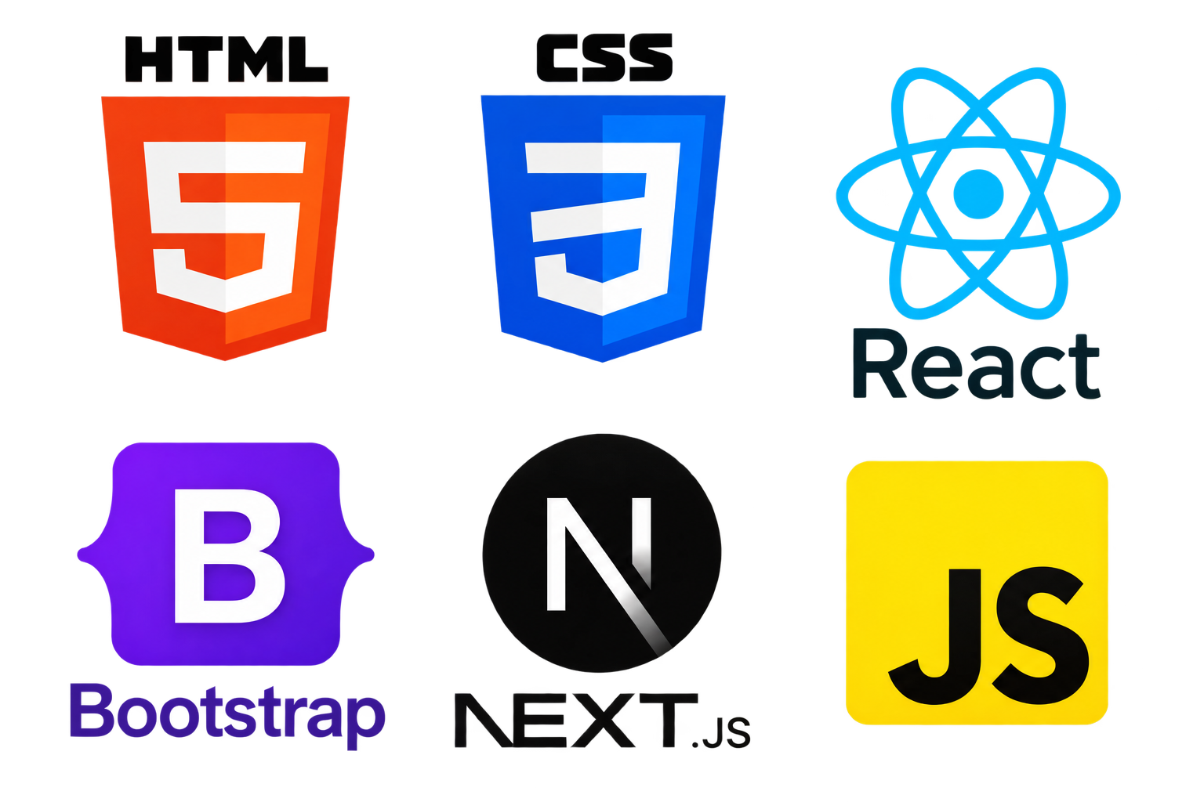
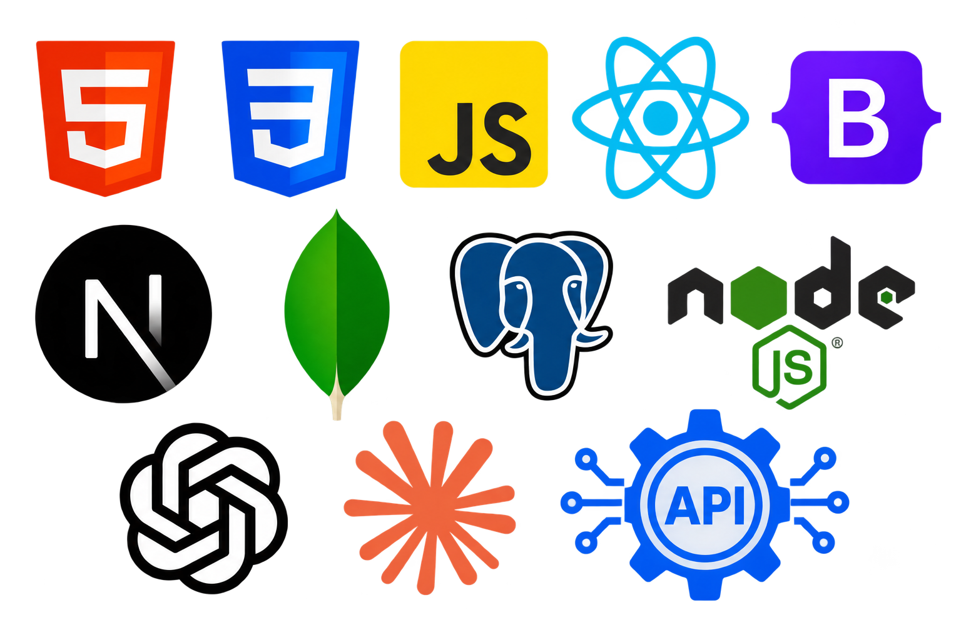
Siddhant saurav 25scs1003002795 BTECH(cse) 3rd Sem LENOVO
AI-Driven-Web-App-Development

Slide 2
Internship Overview
ORGANIZATION | LENOVO
PROGRAM | Lenovo LEAP Internship
INTERNSHIP DOMAIN | WEB DEVELOPMENT
ROLE | Web App Development Intern
DURATION
MODE | REMOTE
15-06-26
To
30-07-26
(6 Week)
The Lenovo LEAP Internship, conducted in collaboration with AICTE, provided valuable industry exposure through hands-on learning and practical experience in a professional environment. The internship helped bridge the gap between academic knowledge and real-world application while strengthening technical skills

Slide 3



Organization Overview
LENOVO LEAP — NEXTGEN SCHOLAR PROGRAM
Lenovo LEAP: NextGen Scholar Program is an industry-driven initiative designed to equip students with essential skills in emerging technologies. The program is offered completely free of cost to all participants in collaboration with the All India Council for Technical Education (AICTE).
Participants work on real-life projects through live masterclasses and mentorship sessions, providing hands-on practical exposure and industry-relevant learning.

Slide 4

INTERNSHIP OBJECTIVES
LEARN → APPLY → DEVELOP → COLLABORATE → GROW
Apply Academic Knowledge — Transform theoretical concepts into practical, real-world solutions.
Learn AI-Driven Development — Understand how AI can be integrated into modern web applications.
Gain Hands-on Experience — Develop practical skills through projects, masterclasses, and guided activities.
Strengthen Problem-Solving Skills — Learn to analyze challenges and develop effective technical solutions.
Enhance Professional Skills — Improve teamwork, communication, collaboration, and time management.
Build Industry Readiness — Gain the confidence and practical exposure required for a professional technology environment.

Slide 5
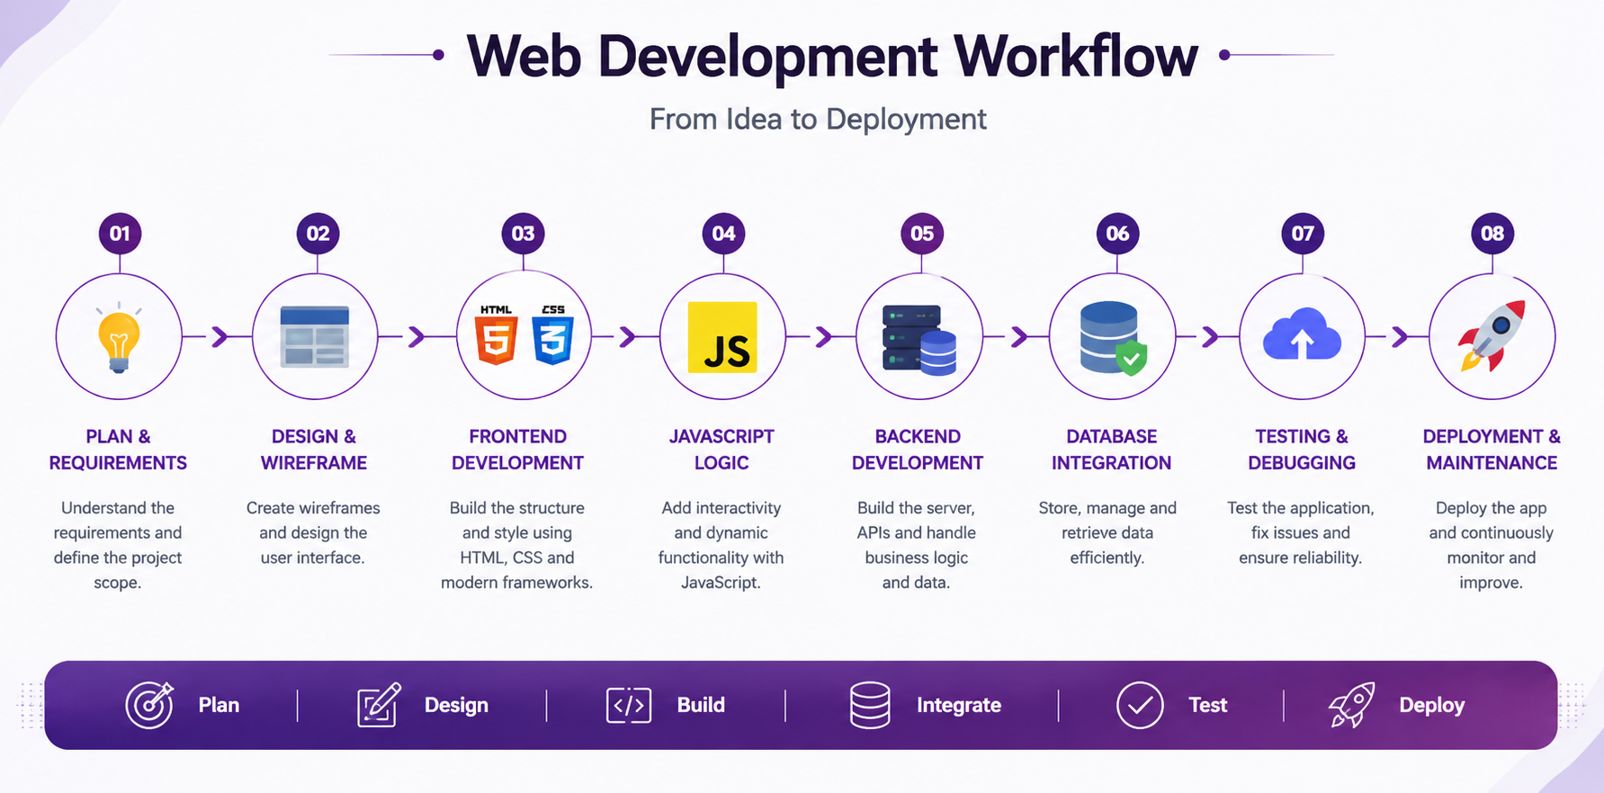
INTERNSHIP ROADMAP
Web Foundations
Final Project & Assessment
(Week 1)
(week 6)
Advanced HTML/CSS
Full-Stack Basics
(week 2)
(week 5)
Build a Website
Backend Development
(week 3)
(week 4)
JavaScript Basics
Advanced JavaScript

Slide 6
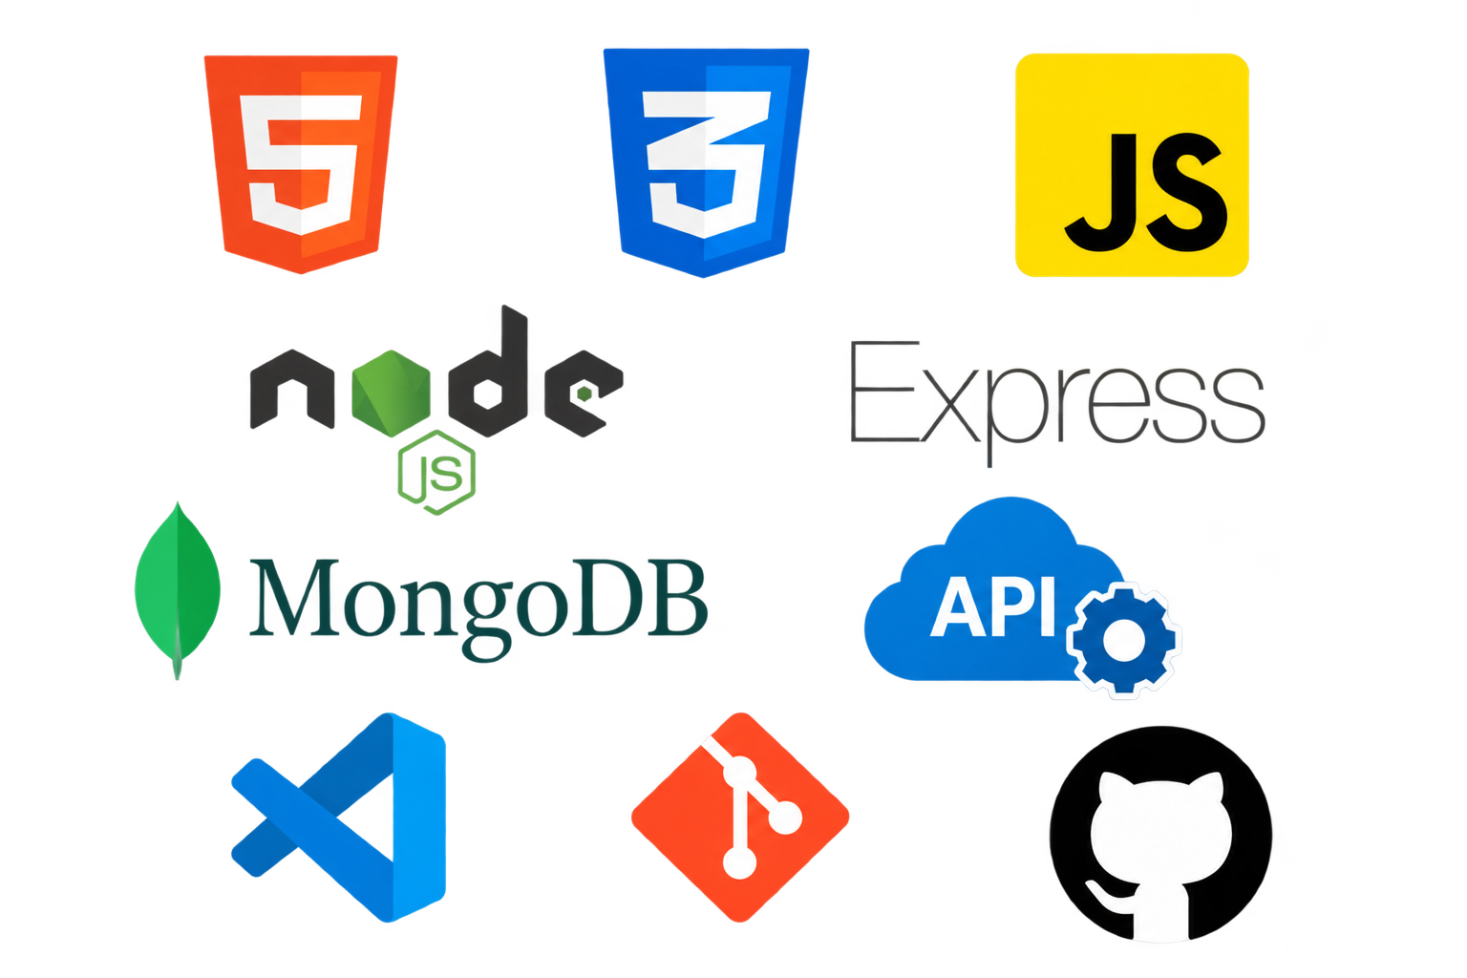
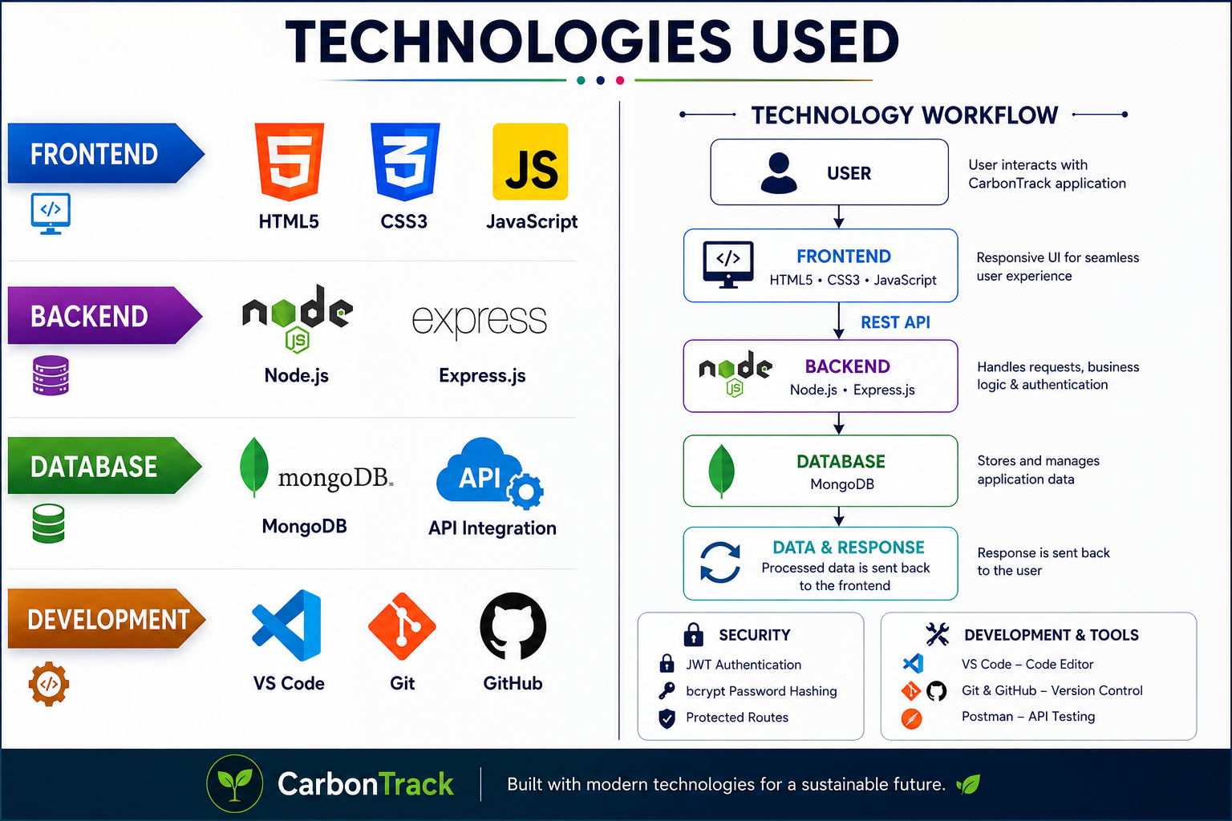
TECHNOLOGIES USED
FRONTEND
HTML5
CSS3
JavaScript
BACKEND
Node.js
Express.js
DATABASE
MongoDB
API Integration
DEVELOPMENT
VS Code
Git
GitHub

Slide 7
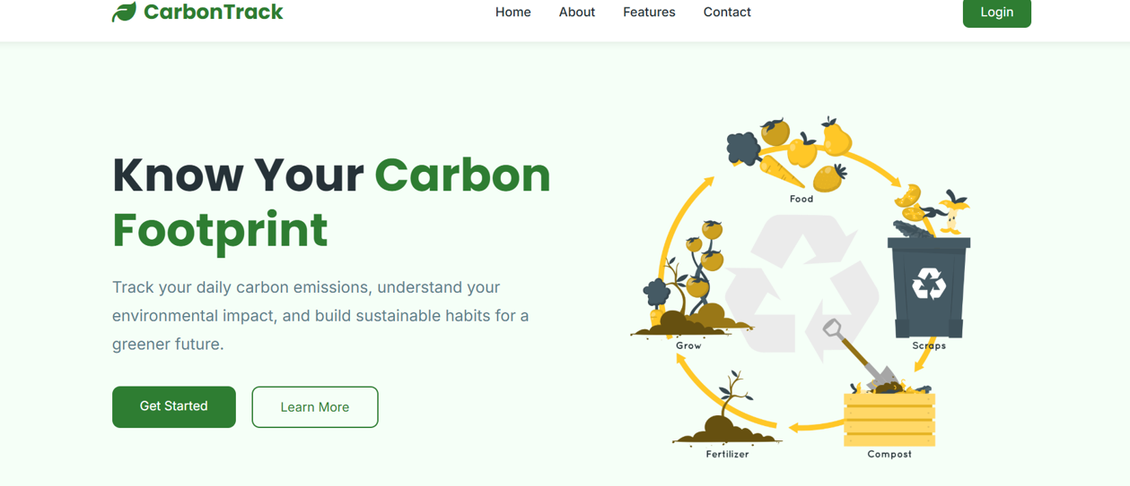
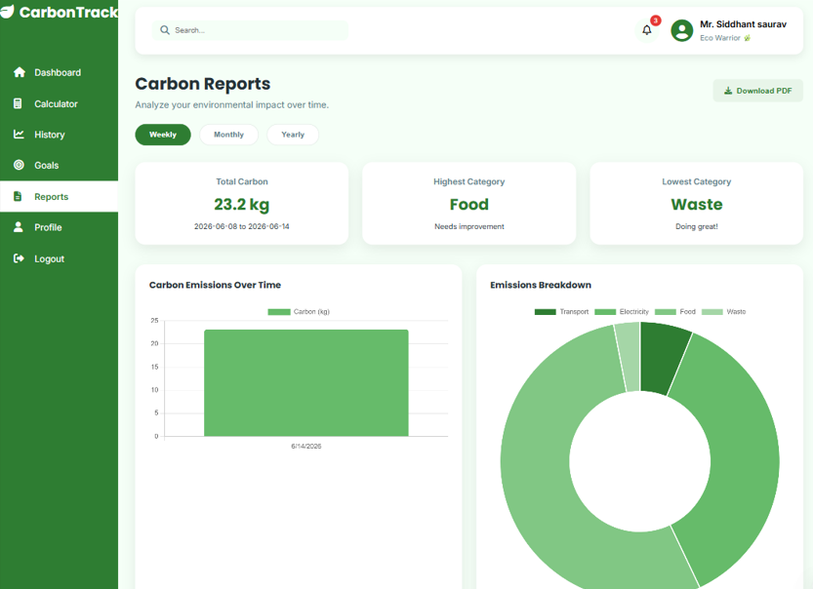
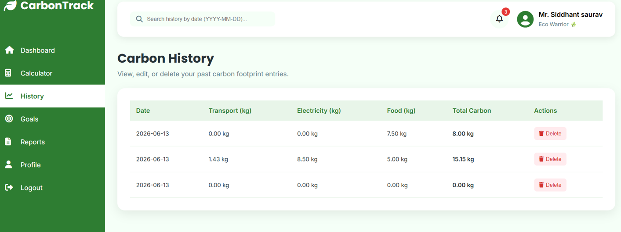
CAPSTONE PROJECT
🌱 CarbonTrack
A full-stack web application designed to help users calculate, monitor, and reduce their carbon footprint.
Individuals often lack a simple way to understand and continuously track the environmental impact of their daily activities.
CarbonTrack converts everyday activities into measurable carbon emissions and provides users with tracking, visualization, history, and sustainability goals.
SOLUTION

Slide 8
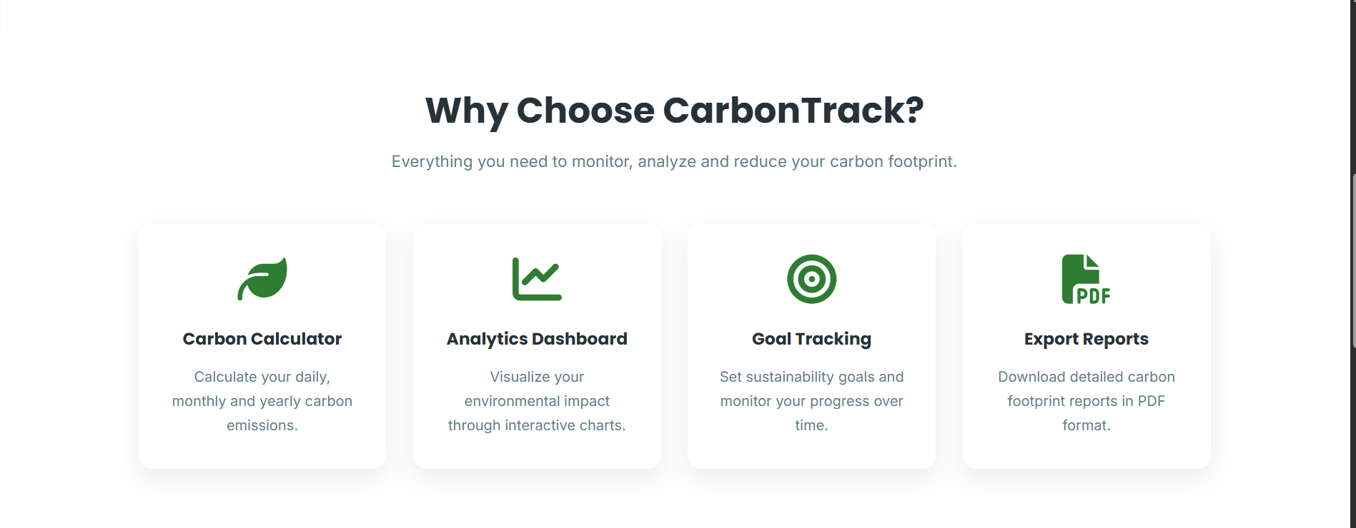
Project Features & Live Links
LIVE LINK
https://carbontrack-fyqt.vercel.app/
SOURCE CODE
https://github.com/sidspy-bug/carbontrack

Slide 9
LEARNING OUTCOMES
🌐 Gained practical knowledge of HTML5, CSS3 & JavaScript
📱 Learned to develop responsive and interactive web interfaces
⚙️ Developed backend applications using Node.js & Express.js
🔐 Implemented secure authentication using JWT & bcrypt
🗄️ Gained expertise in MySQL, database design & CRUD operations
🔗 Developed REST APIs & frontend–backend integration
🧩 Learned MVC architecture, API testing & debugging
🚀 Applied Git/GitHub and full development workflow to build & deploy CarbonTrack

Slide 10
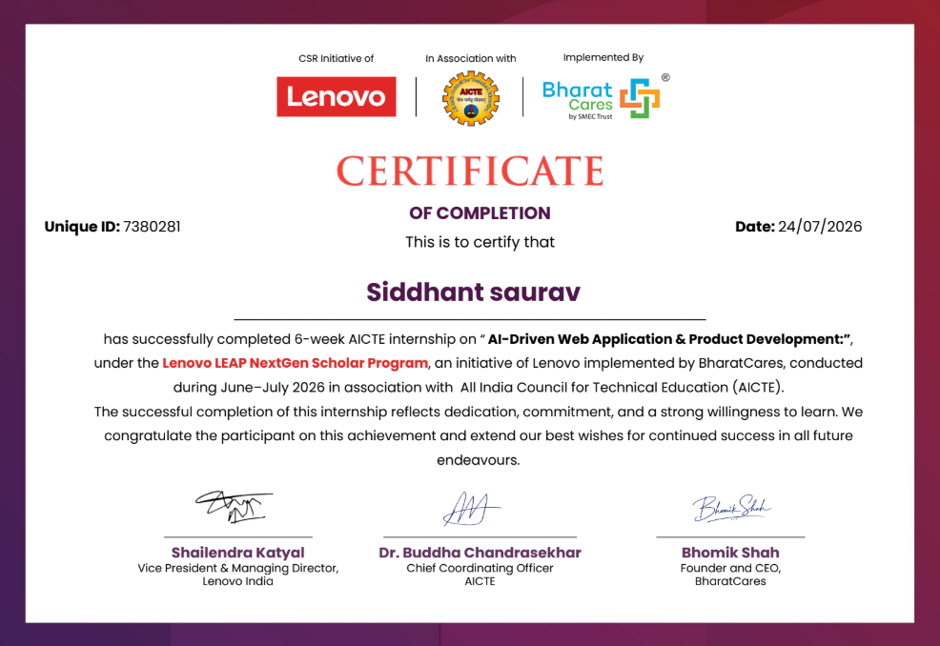

ASSESSMENT & CERTIFICATION

